Slide 1
Radiosity

Slide 2
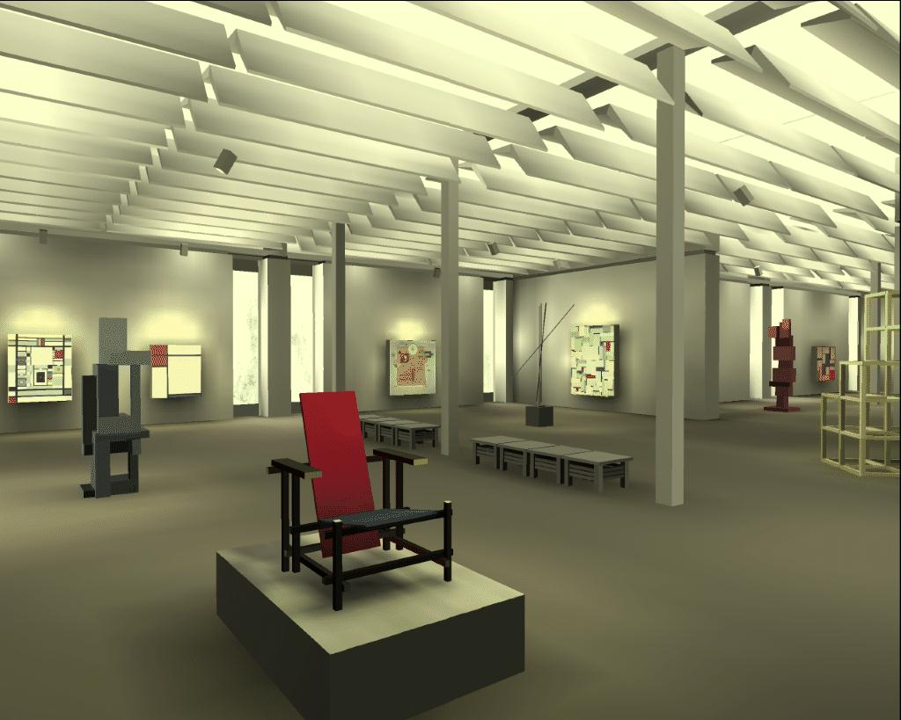
What is Radiosity
Borrowed from radiative heat transfer.
Assuming diffuse reflectance.
View independent solution.
The image appeared on the proceedings cover of SIGGRAPH 1988.
https://www.graphics.cornell.edu/resources/images-animation/research-images/museum

Slide 3
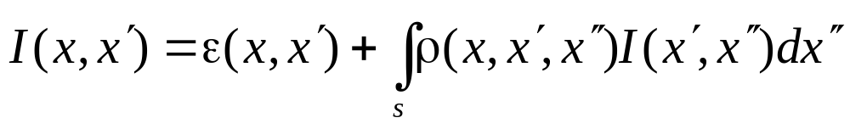
Rendering Equation (Review)
g() removed.
ρ() is related to BRDF.

Slide 4
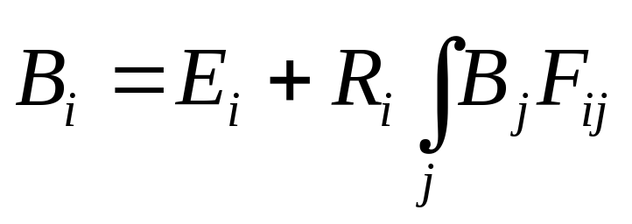
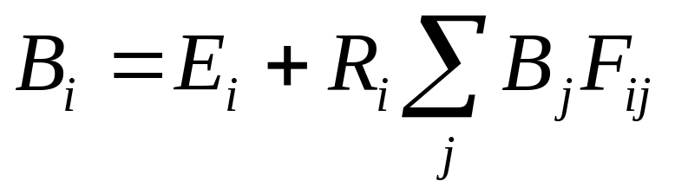
Radiosity Equation – Single Patch
Discrete form:
Compared to Rendering Equation:

Slide 5
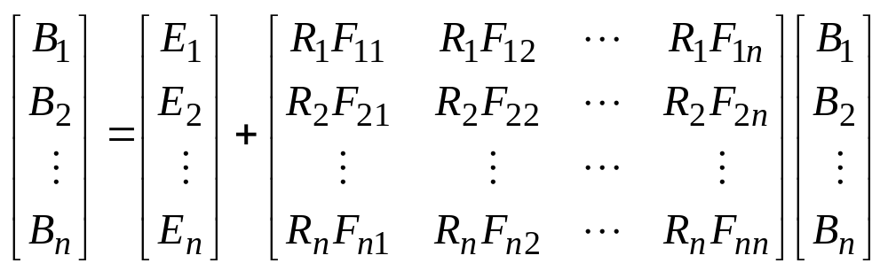
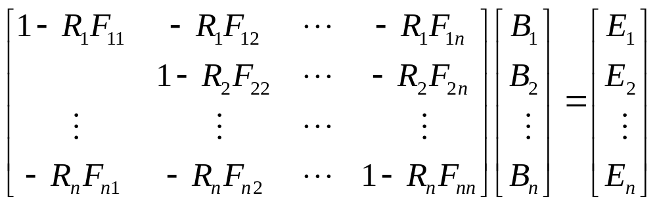
Radiosity Equation – In Matrix Form
➔

Slide 6
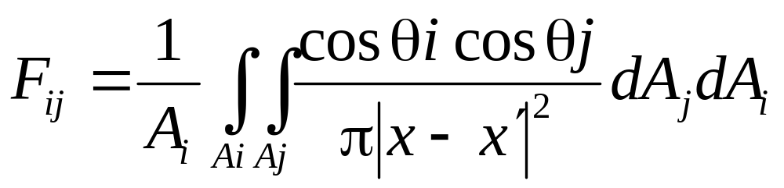
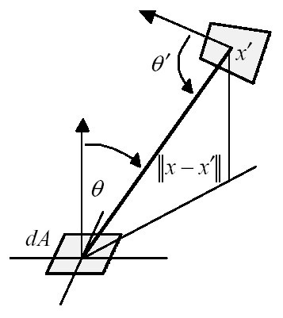
Form Factor Calculation

Slide 7
Form Factor Calculation
Analytical forms of form factors are possible for simple shapes only.
Form factor is reduced if a patch sees the other patch partially.
An approximation – Hemicube.
One hemicube for each patch.

Slide 8
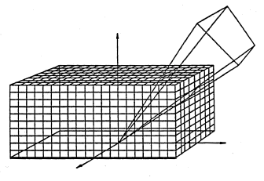
Hemicube
Patch j
Hemicube
Patch i

Slide 9
Solving the Linear Equation
Direct method: Gaussian Elimination O(n³)
Iterative method: Gauss-Seidel or Jacobi method O(n²)

Slide 10
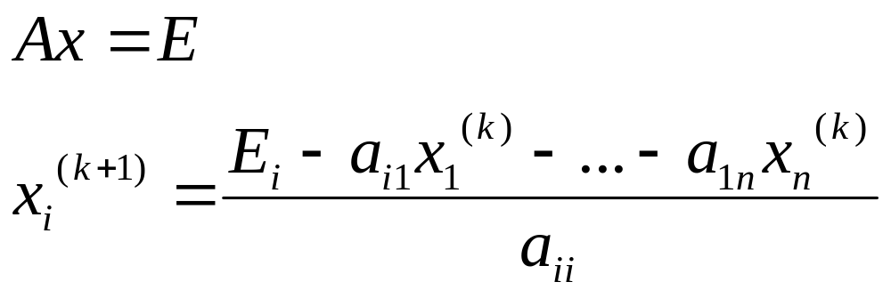
Jacobi Iterations
Take a initial guess {x_{i}⁰} , for i=1..n
Each iteration produces better {x_{i}^{(k+1)}} from {x_{i}^{(k)}}

Slide 11
Gauss-Seidel Variation
New x_{i}’s in iteration k+1 are used whenever they are available.
That is: x_{i}^{(k+1)} uses x₁^{(k+1)}… x_{i-1}^{(k+1)} and x_{i+1}^{(k)}… x_{n}^{(k)}
Iteration k+1
Iteration k

Slide 12
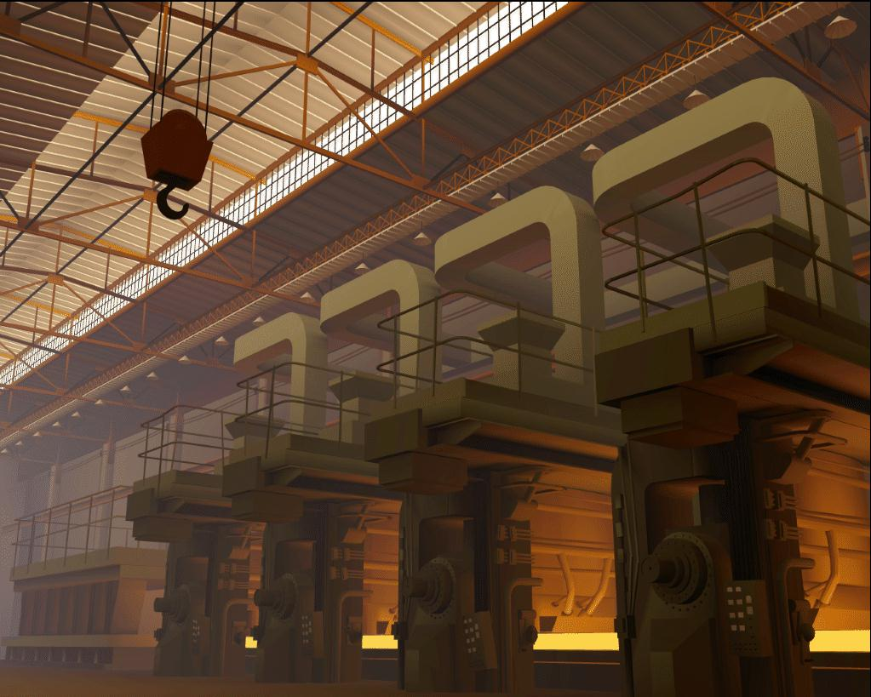
Progressive Refinement
Allowing the viewing of early incomplete solution
Start from the patch with greatest unshot radiosity.
Update receiving patches. Repeat.
https://www.graphics.cornell.edu/resources/images-animation/research-images/radiosity-factory-research-gallery

Slide 13
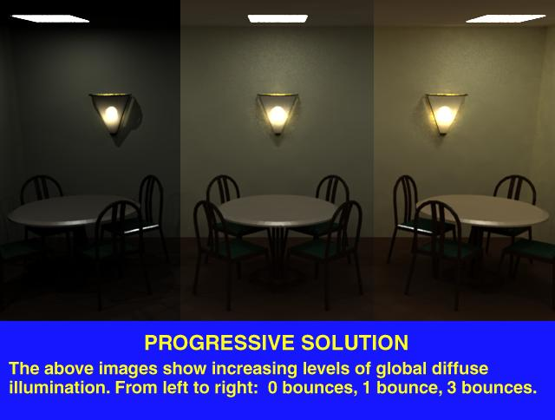

Slide 14
Artifacts
Interpolation necessary to smooth out the patches.
Blocky shadow is still a problem.
Meshing resolution is important to the final quality.

Slide 15
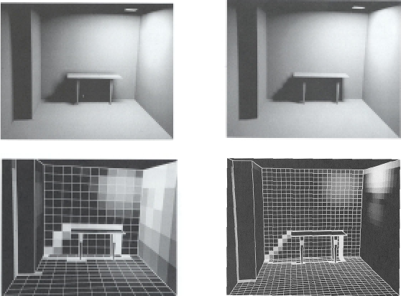
Meshing

Slide 16
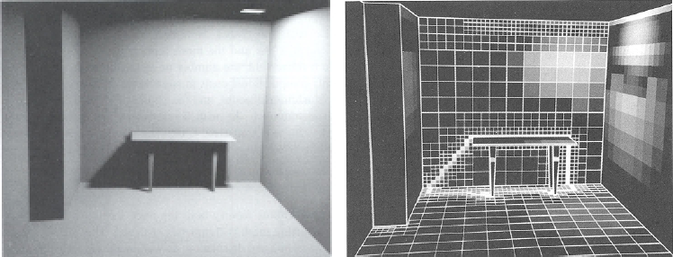
Adaptive Meshing
Subdivide a patch if the radiosity variation is large.

Slide 17
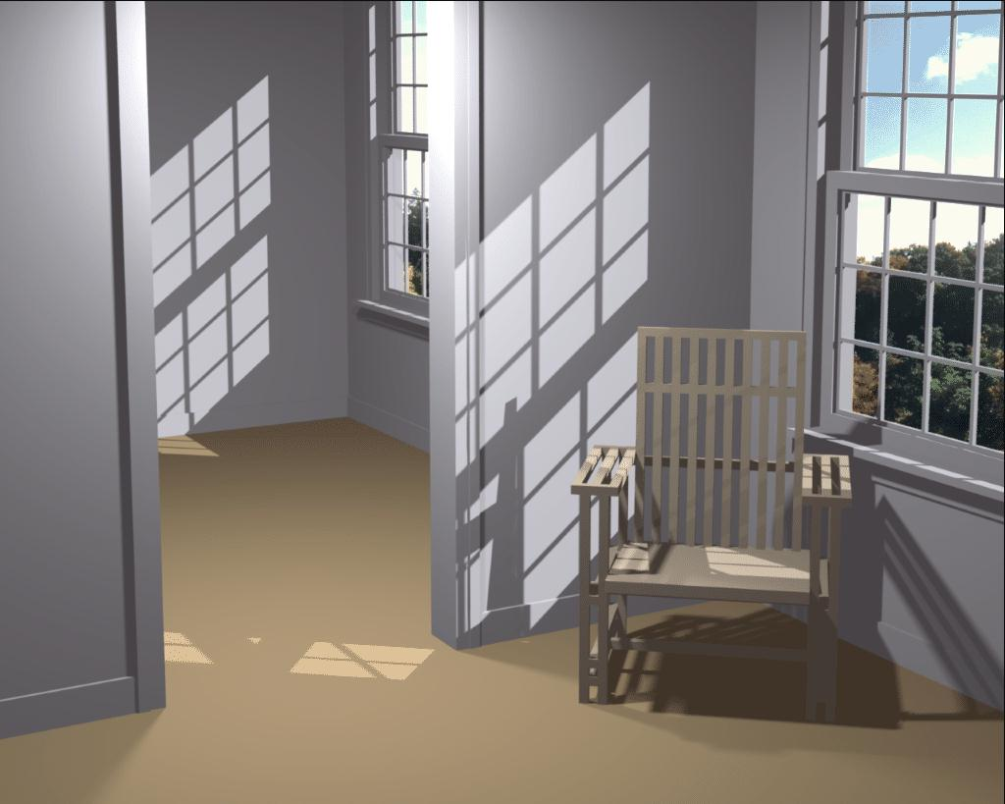
Advanced Techniques
Discontinuity Meshing.
Hierarchical Radiosity.
See Watt’s Section 11.7.2 for details.
https://www.graphics.cornell.edu/resources/images-animation/computer-graphics-images/discontinuity-meshing

Slide 18
For Further Information
Hughes & van Dam’s book 31.10.
Watt’s book 10.3.2 and Chapter 11.
(Pharr’s book doesn’t cover radiosity because it mainly uses Monte Carlo path tracing.)

